Slide 1
scholarsphere
Group 20

Slide 2
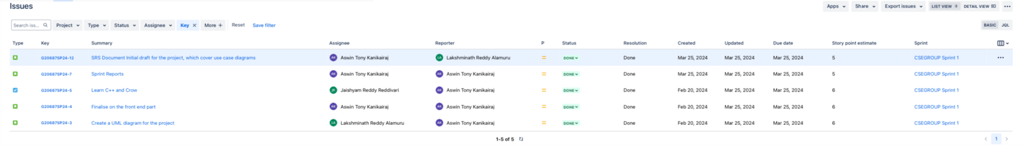
Sprint 1

Slide 3
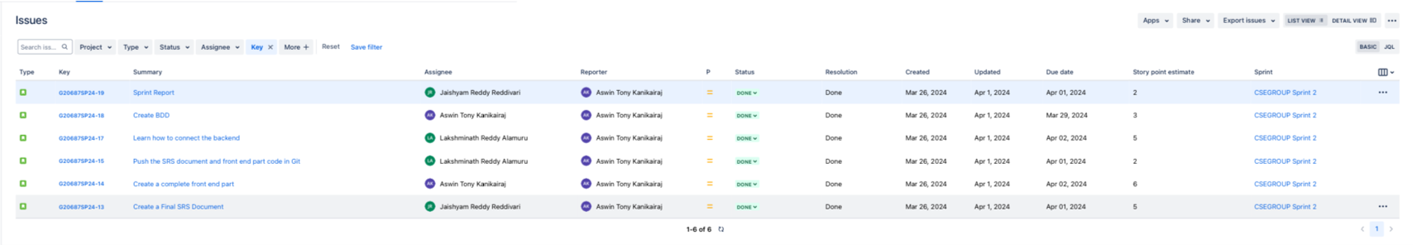
Sprint 2

Slide 4
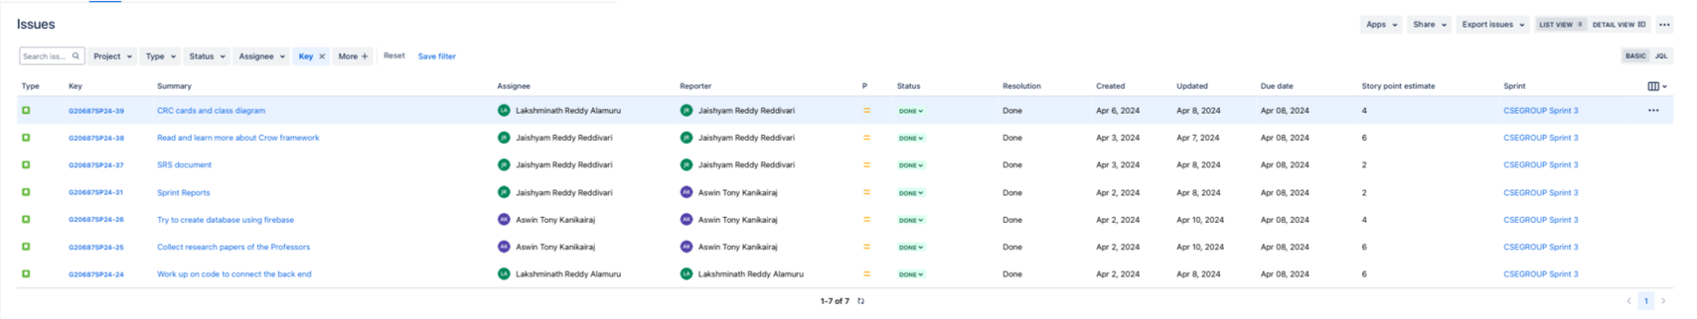
Sprint 3

Slide 5
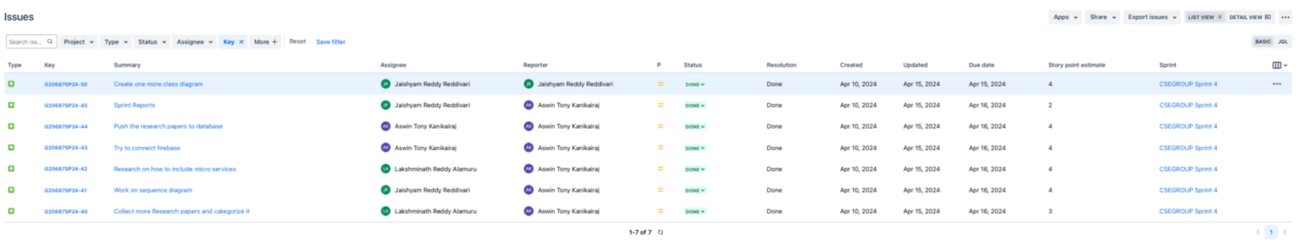
Sprint 4

Slide 6
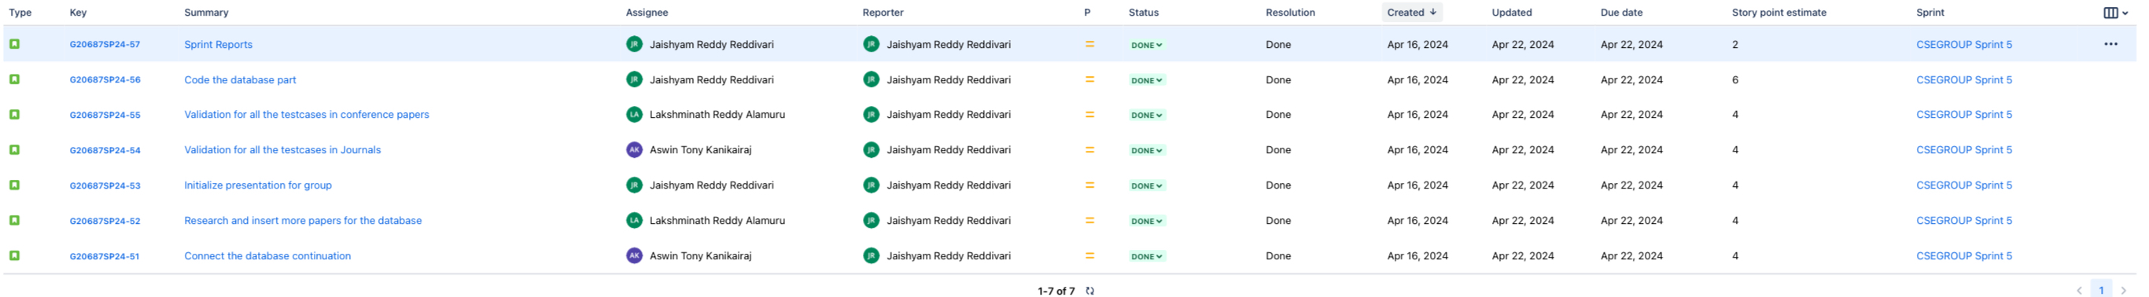
Sprint 5

Slide 7
Sprint 6

Slide 8
Sprint 7

Slide 9
Sprint Overview
Sprint | Number of stories closed | Number of stories rolled over | Story points
Sprint 1 | 5 | 0 | 28
Sprint 2 | 6 | 0 | 23
Sprint 3 | 7 | 0 | 30
Sprint 4 | 7 | 0 | 26
Sprint 5 | 6 | 0 | 29
Sprint 6 | 7 | 0 | 20
Sprint 7 | 7 | 0 | 26
The average number of closed stories per sprint are 6.4.
The average number of stories rolled over are 0.
The total number of story points that the team has logged are 182.

Slide 10

ScholarSphere Web Page
Login Page:

Slide 11

User Interface:

Slide 12

User Interface:

Slide 13
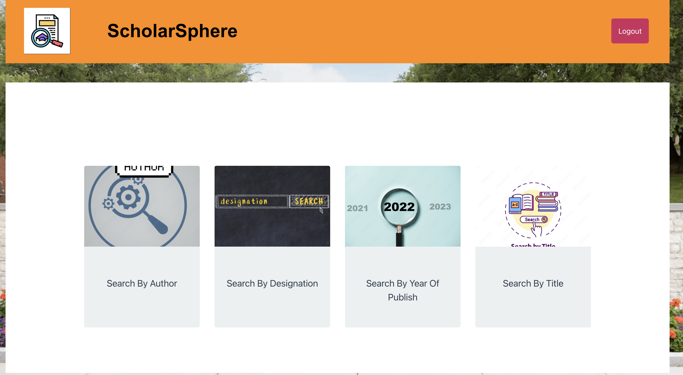
User Interface:

Slide 14
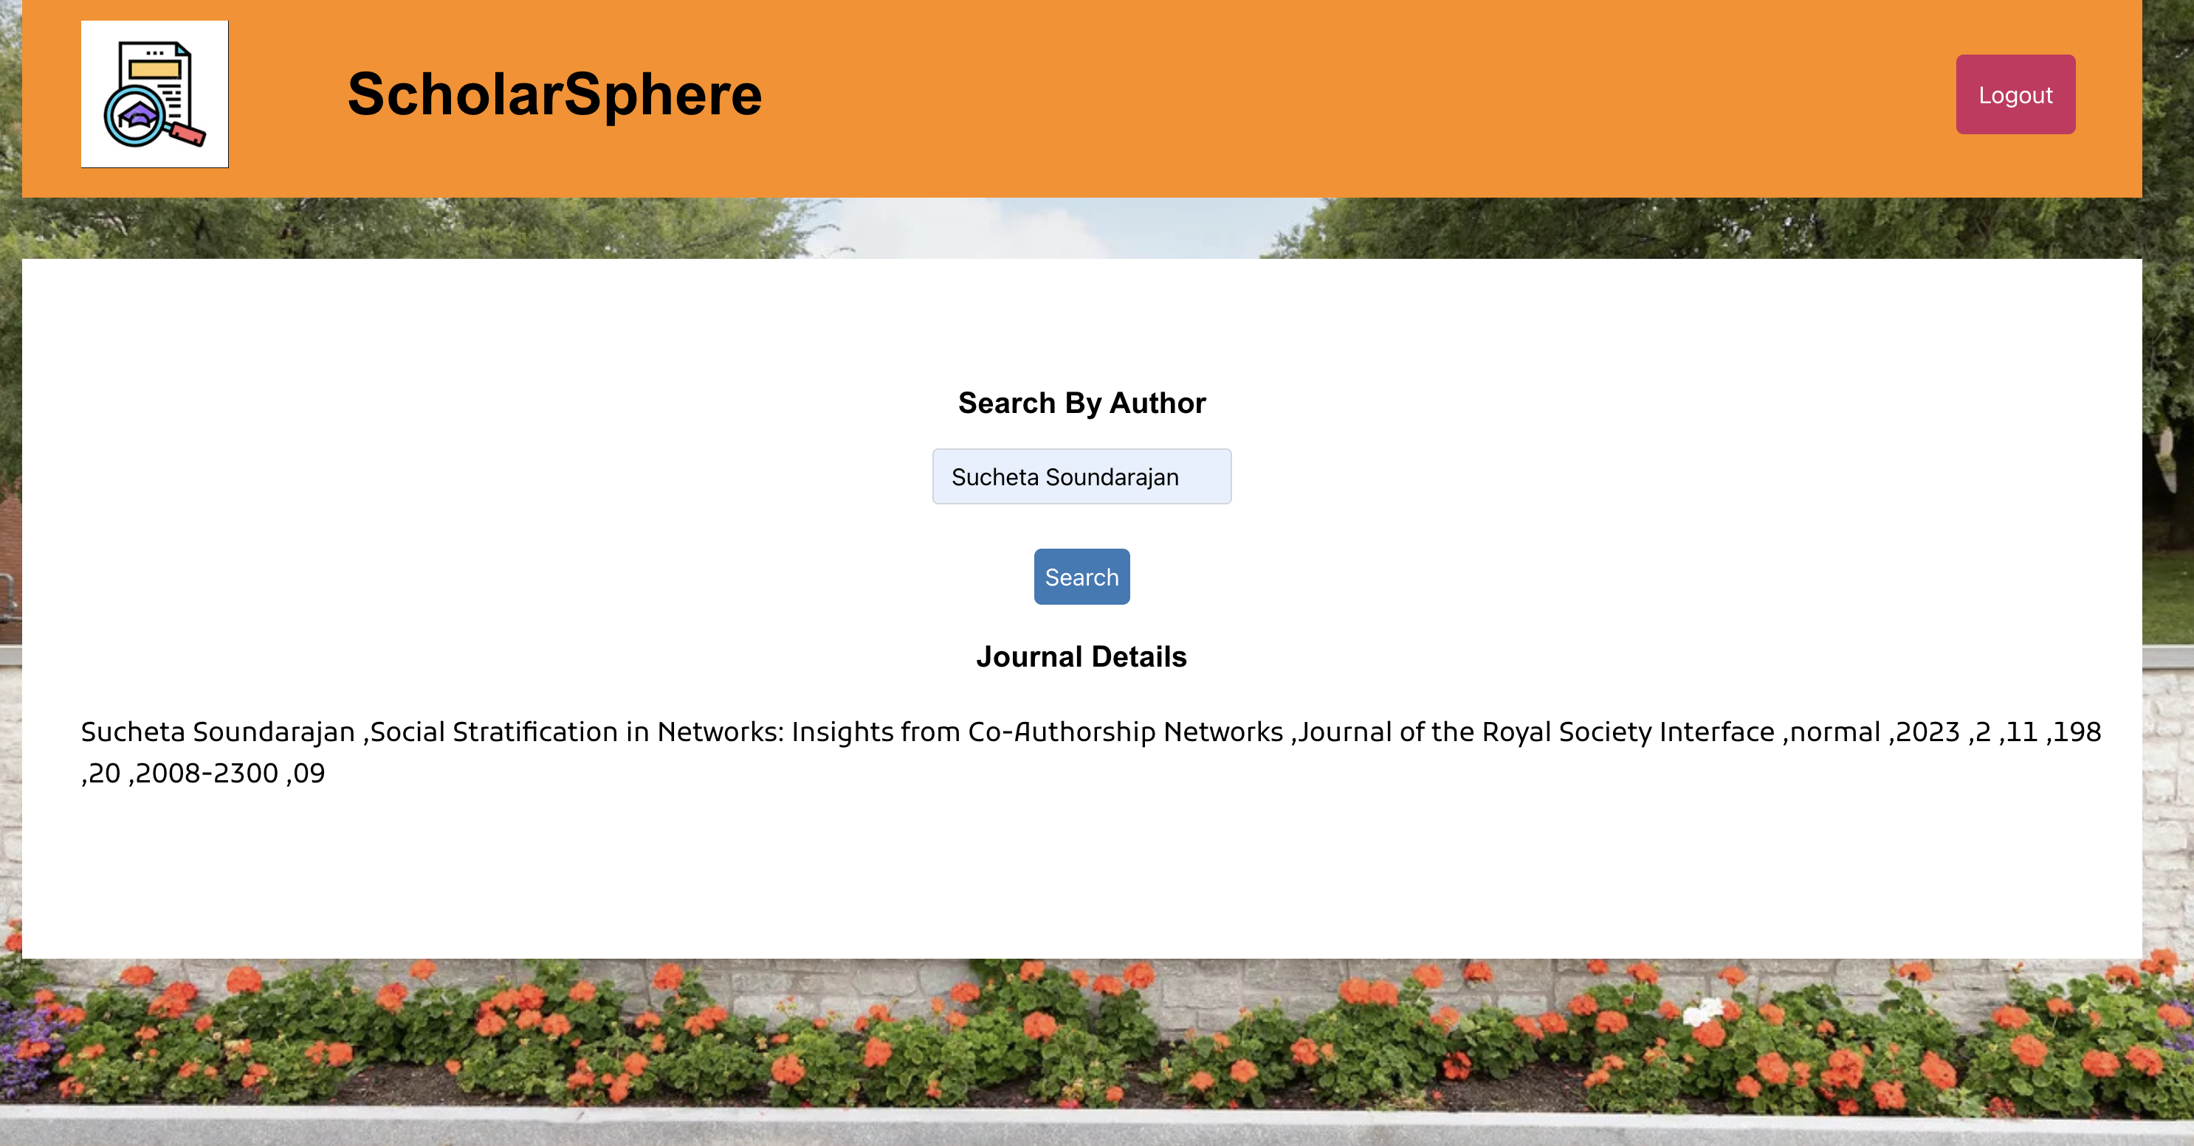
User Interface:

Slide 15
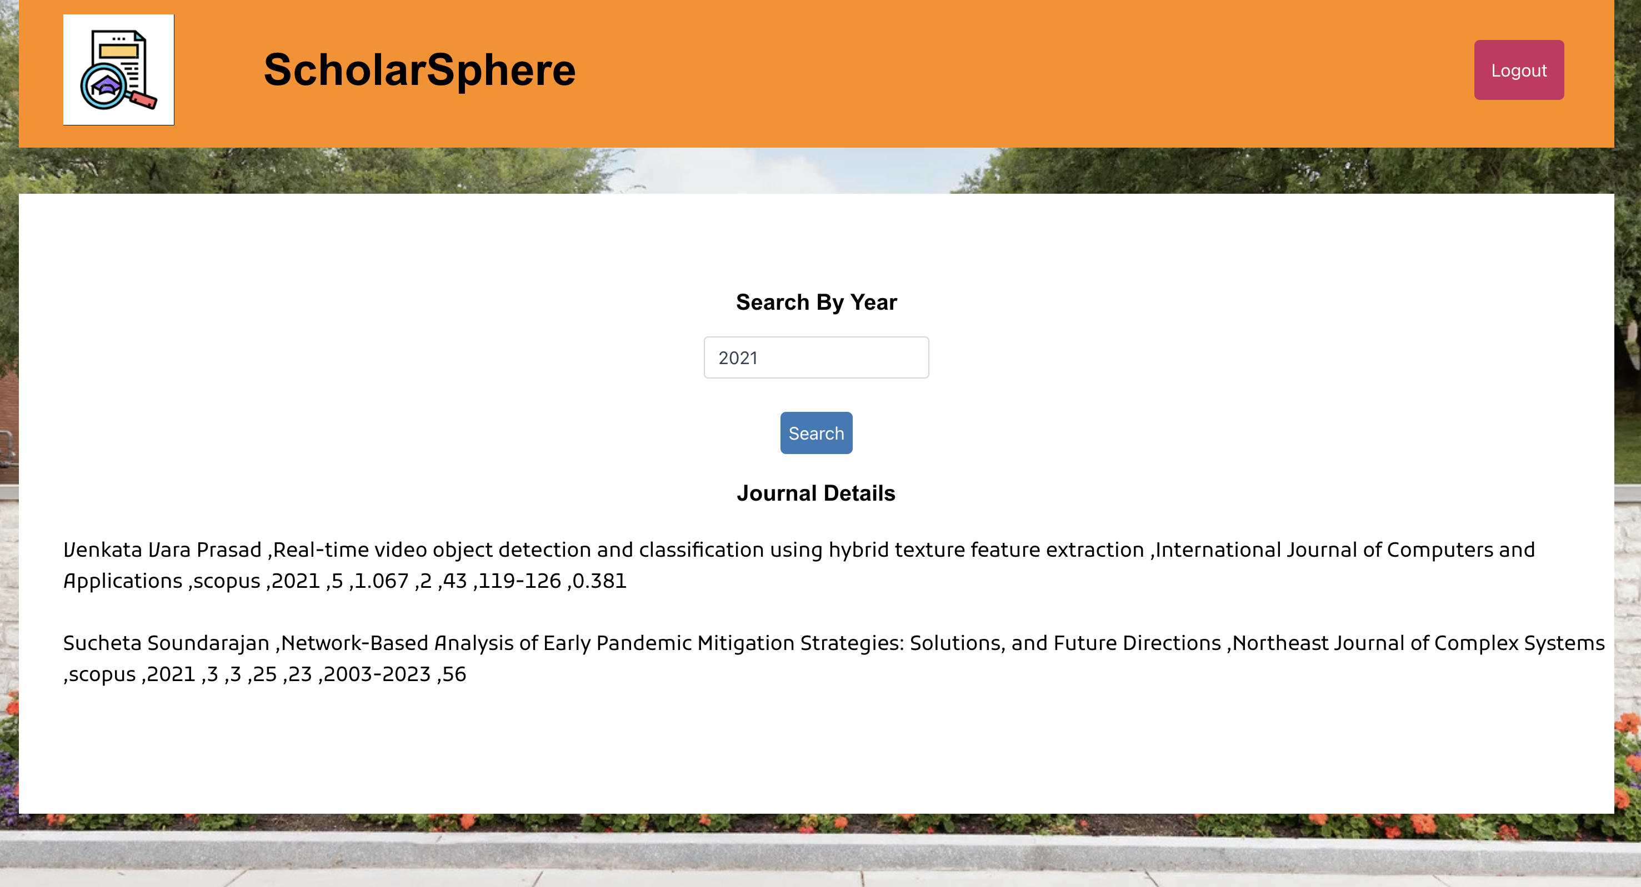
User Interface:

Slide 16
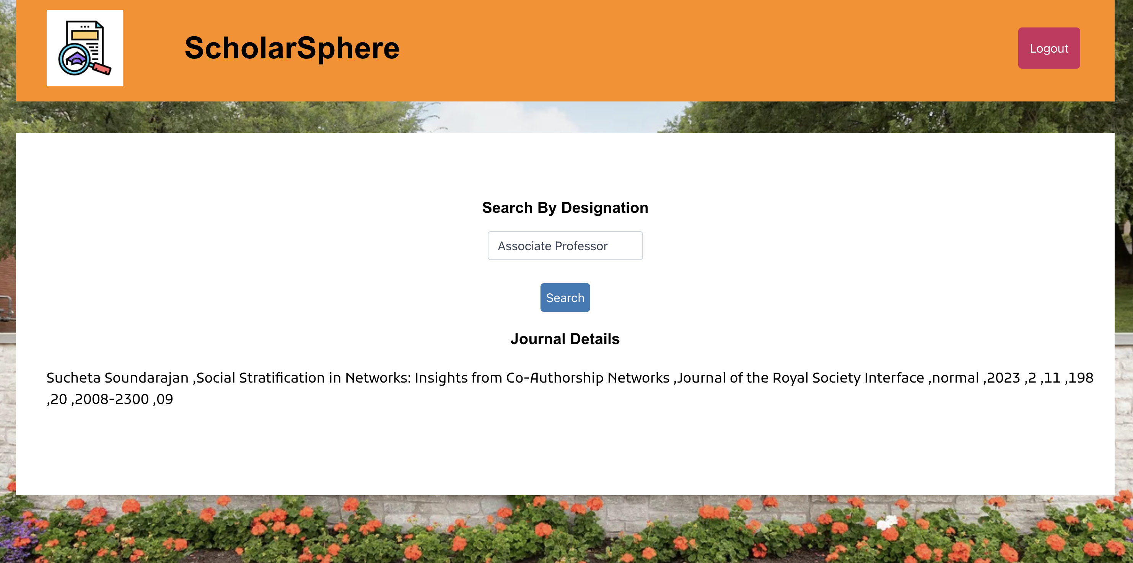
User Interface:

Slide 17

Admin Interface:

Slide 18

Admin Interface:

Slide 19
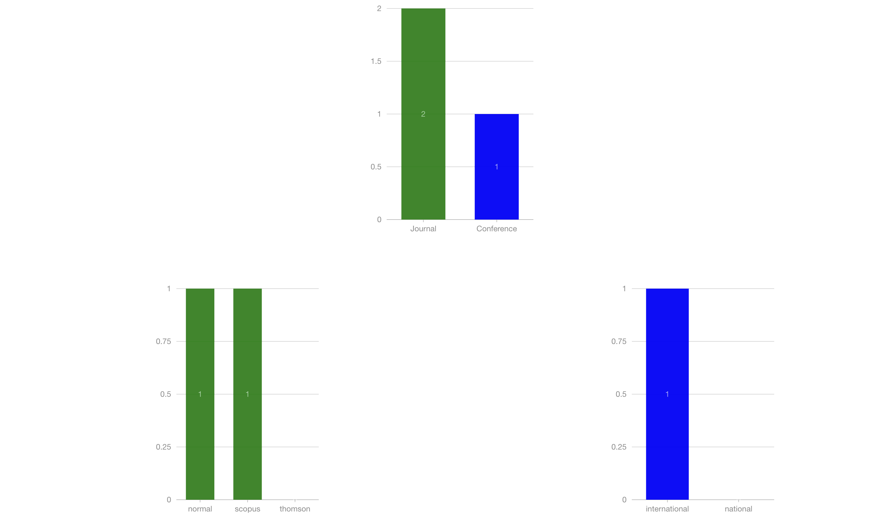
Admin Interface:

Slide 20

Admin Interface:

Slide 21
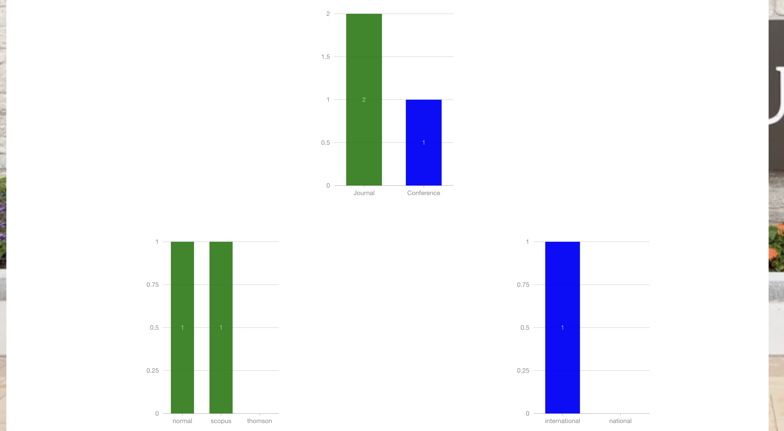
Admin Interface:

Slide 22

Admin Interface:

Slide 23
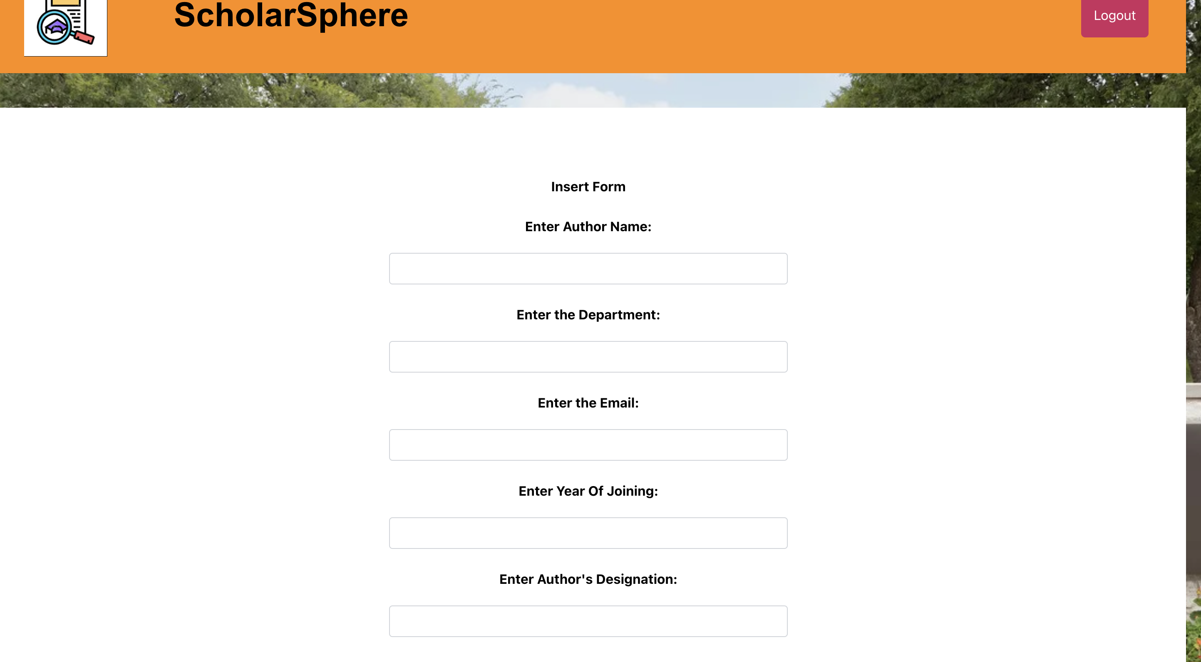
Admin Interface:

Slide 24
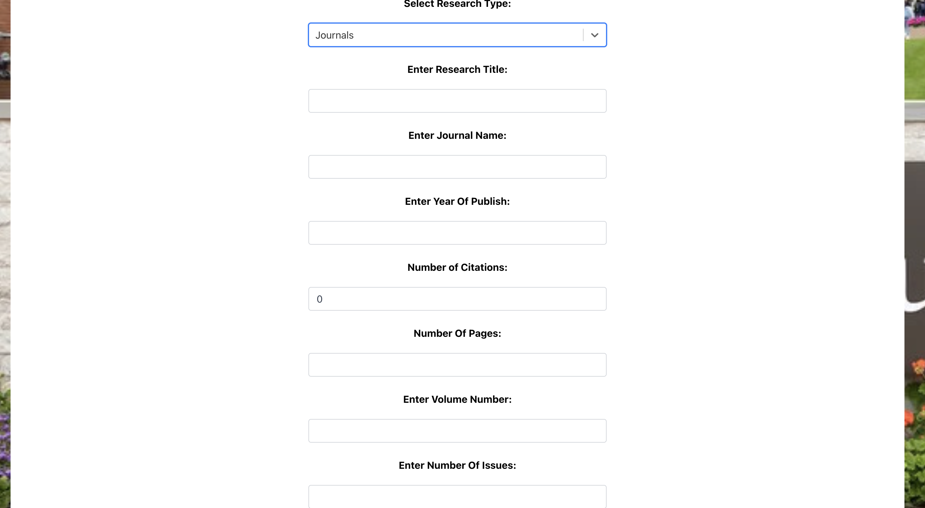
Admin Interface:

Slide 25

Admin Interface:

Slide 26
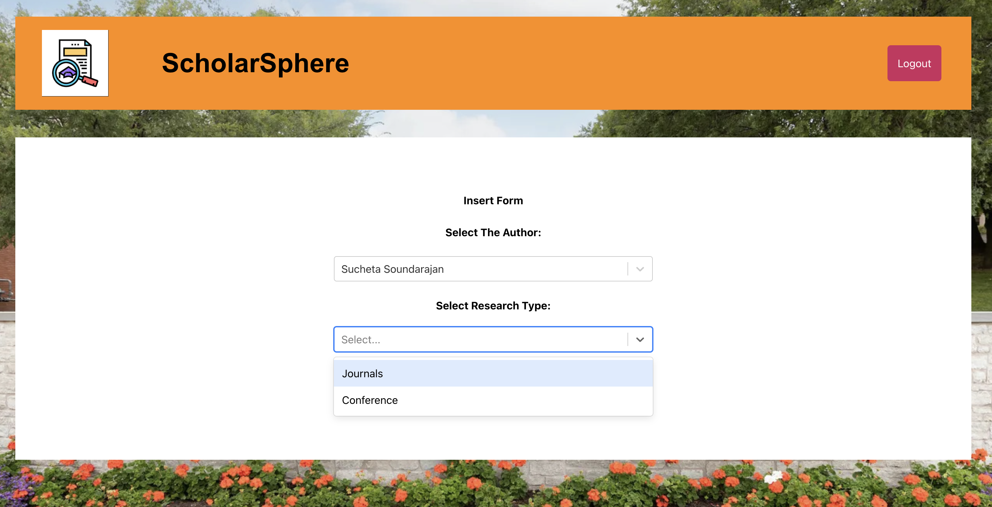
Admin Interface:

Slide 27
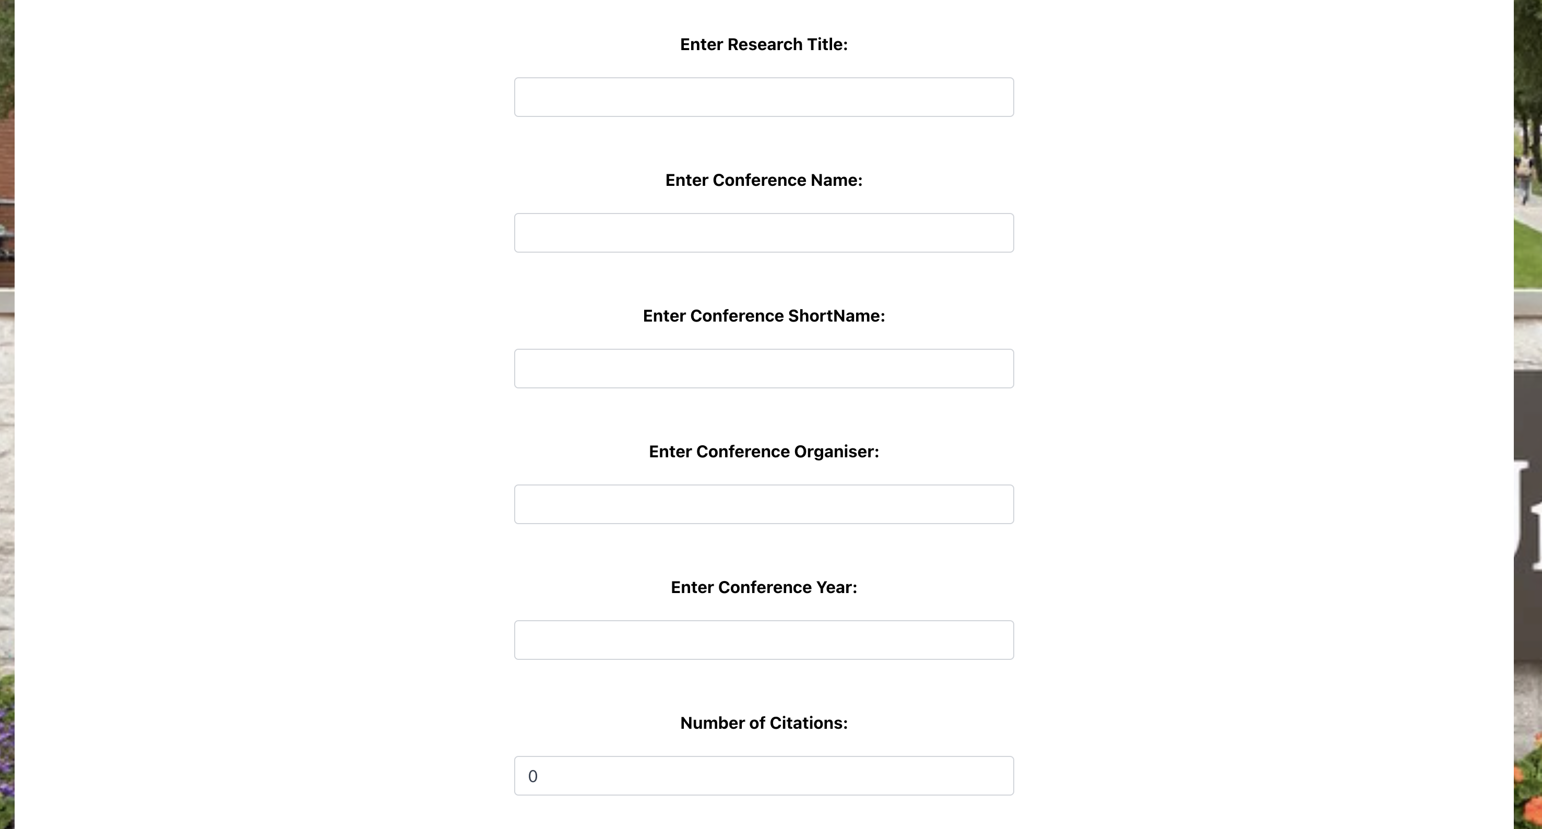
Admin Interface:

Slide 28

Admin Interface:

Slide 29
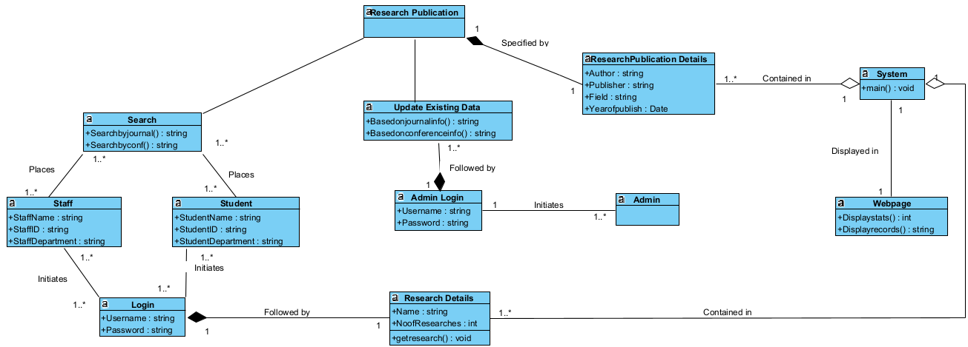
Class Diagram 1

Slide 30
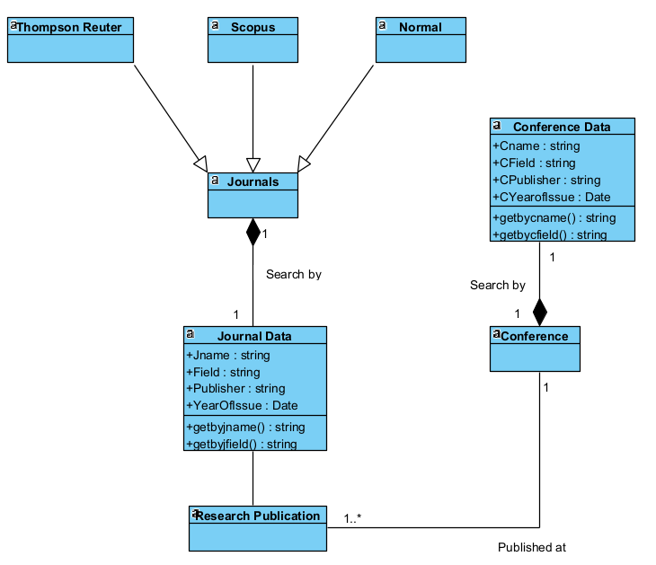
Class Diagram 2

Slide 31
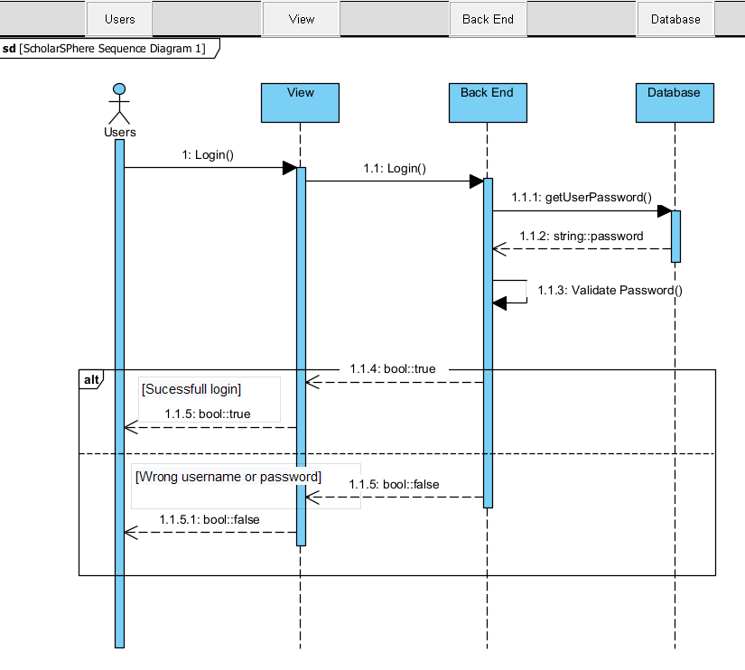
Sequence Diagram 1

Slide 32
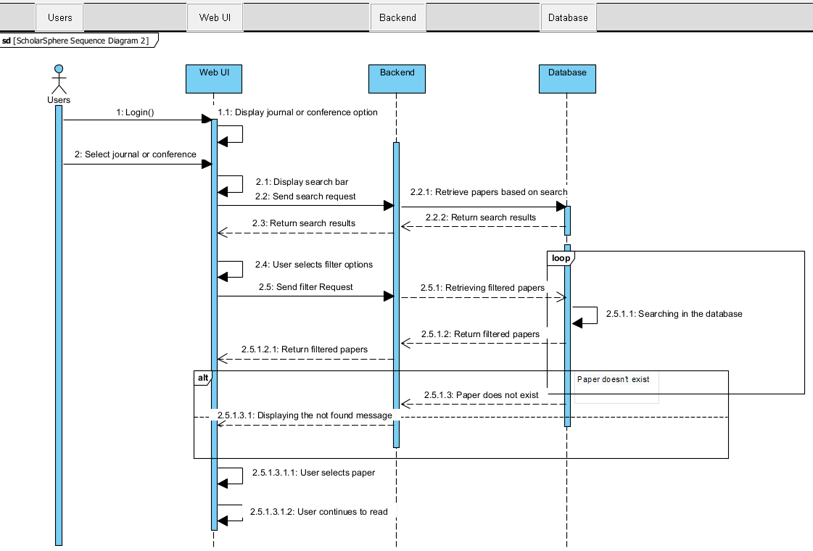
Sequence Diagram 2

